Slide 1
Program development life cycle
When a person, or organisation, creates a new computer program they will use a structured, organised plan of how to create the program.
This is called the program development life cycle.
The stages of the program development life cycle are:
» analysis
» design
» coding
» testing

Slide 2
Analysis
Before any problem can be solved, it needs to be clearly defined and set out so anyone working on the solution understands what is needed.
This is called the ‘requirements specification’ for the program.
The analysis stage uses abstraction and decomposition tools to identify exactly what is required from the program.
Abstraction keeps the key elements required for the solution to the problem and discards any unnecessary details and information that is not required.

Slide 3
Decomposition breaks down a complex problem into smaller parts, which can then be subdivided into even smaller parts, that can be solved easily.
Subproblems allow the developers to identify the requirements for each component part, and then tackle these separately in the next stage.
The component parts of any computer system are:
» inputs
» processes
» outputs
» storage

Slide 4
Design
Once the requirements have been identified, the program designers can begin planning how the program will work in the design phase.
This can include an overview of the program using a structure diagram, and the designing of algorithms using flowcharts and pseudocode.

Slide 5
Coding and iterative testing
The set of programs is developed using a suitable programming language and then tested to see if it works.
Iterative testing means that modular tests are conducted, code amended, and tests repeated until the module performs as required.

Slide 6
Testing
When you have finished your program, you need to carry out testing to make sure it:
• fully works
• does not crash
• meets all requirements.
There are four types of test data:
Normal - data that the program should accept.
Abnormal - data that the program should not accept.
Extreme - data that is at the edge of what is accepted/ allowed .
Boundary - data that is on the edge of being accepted and being rejected .

Slide 7
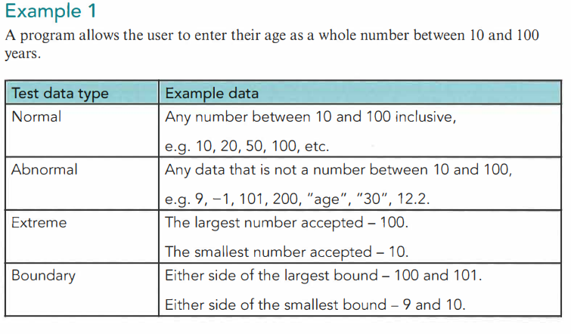

Slide 8
